Slide 1


Phonic Screening Check 2020

Slide 2
What is the Phonic Screening Check (PSC)?
A statutory assessment for all children in Year 1.
All children in Year 1 will usually complete the assessment in June. Due to Covid 19 this year it will be during the Autumn term for children in Year 2.
It consists of 40 words that each child must read one-to-one with a teacher.
It is a combination of real and pseudo (alien) words.

Slide 3
What is the Phonic Screening Check (PSC)?
The Phonic Screening Check is not a reading test.
It is an assessment of your child’s ability to decode words using their phonic knowledge.

Slide 4
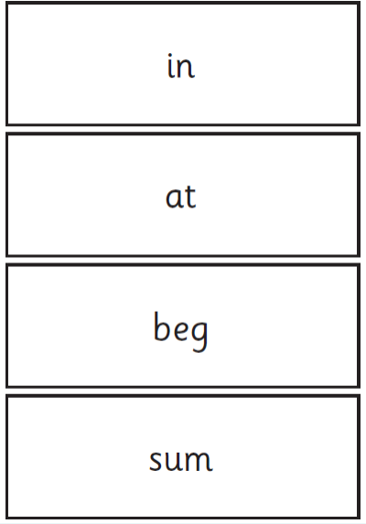
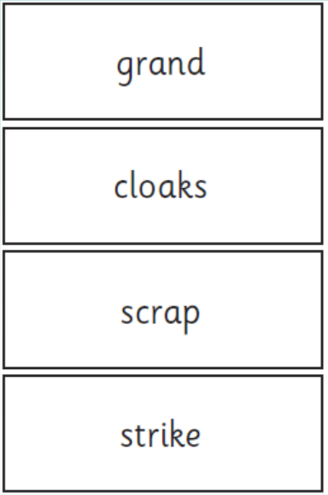
Example of real words which may be included

Slide 5

What are pseudo words or alien words?
Pronounceable combinations of letters that can be read by the application of grapheme-phoneme conversion rules, but they are, by definition, not real words
in English.

Slide 6
Why have pseudo been included?
Non-words are new to all children and therefore test their ability to decode words. This means that they do not favour children with good vocabulary or visual memory of words, therefore the check tests them on their ability to use phonics to read words.
All non-words in the screening check are accompanied by a picture of an imaginary creature to provide a context for the pupil (naming the type of imaginary creature). This is to ensure that they are not trying to match the non-word to a word in their vocabulary.

Slide 7
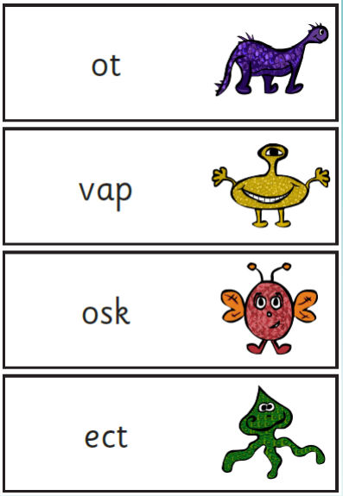
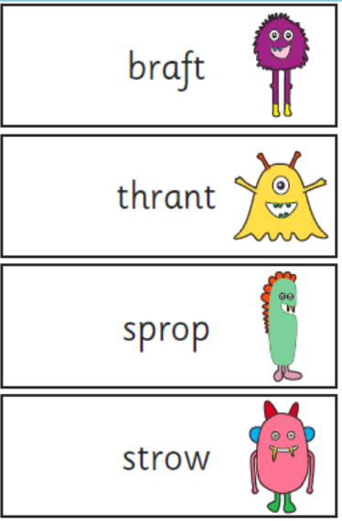
Example of alien words which may be included?

Slide 8
Structure and Content
The assessment is divided into two sections.
Section 1
A variety of simple word structures (CVC - cat, VCC - ant, CCVC - step and CVCC - past) using single letters (a, b, c and so on), some consonant digraphs (ch, ck, ff, ll, ng, sh, ss, th, zz) and frequent and consistent vowel digraphs (ar, ee, oi, oo, or).
Section 2
This will contain a variety of more complex word structures (CCVCC - stand, CCCVC - scrap, CCCVCC - spring and two syllable words) with some additional consonant digraphs (ph, wh), some less frequent and consistent vowel digraphs including split digraphs (a-e, e-e, i-e) and trigraphs (air, igh).

Slide 9
How will the Phonics Screening Check
be carried out?
• Prior to the test children will be shown practice sheets with examples of real and non-words. Therefore, when they come to do the real assessment the materials will be familiar
to them.
• The assessment will be carried out by a teacher familiar to your child.
• It will occur in a comfortable, noise free and well lit environment away from distractions.

Slide 10
How will the Phonics Screening Check
be carried out?
• There is no time limit for the test but it normally takes between 4 and 9 minutes per child.
• If the teacher administering the test believes a child is finding it difficult to concentrate during the PSC then rest breaks may be taken when needed.
• Modifications may be made to the PSC to suit the individual needs of children e.g. font size, reducing the number of words on each page.

Slide 11
How are we helping the children
to prepare for the PSC?
• Focused daily Phonics lessons planned specifically for the phase that the children are currently working at.
• Phonics assessments are carried out every term to assess which Phase each child is at. Children at Robert Arkenstall should reach Phase 6 by the end of Year 2.
• Individual and small group reading with children – they are encouraged to decode unfamiliar words using their phonic knowledge.

Slide 12
How are we helping children
to prepare for the PSC?
Individual or small group work focused on gaps in phonics knowledge.
The use of ICT to keep learning interactive, visual and engaging.
Websites we use at school
https://www.phonicsplay.co.uk/
https://www.galacticphonics.com/

Slide 13
How can you help your child at home?
When reading at home encourage children to sound out both familiar and unfamiliar words in their books.
Encouraging children to read everywhere e.g. whilst shopping.
Word games e.g. I spy, snap.
Making up non-words of their own.
Direct your child to the following games on Phonics Play.

Slide 14
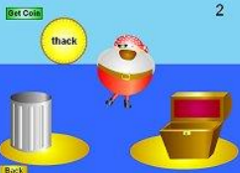

How can you help your child at home?
Direct your child to the following games on Phonics Play.
https://www.phonicsplay.co.uk/resources/phase/2/buried-treasure
https://www.phonicsplay.co.uk/resources/phase/2/dragons-den

Slide 15
How will I know if my child has met the PSC standard?
The school will inform you once the pass mark has been published by the Government, this should be early
in the Spring term 2021.
What does this mean?
They have a secure knowledge of the phonic content that has been taught in Year 1 and they are able to apply it when reading. In 2019 this meant that children had read at
least 32 out of 40 words correctly.

Slide 16
How will I know if my child has not met the PSC standard?
• They will receive further support during Year 2 including small group work and 1:1 catch up programmes if necessary.
• Daily phonic lessons will focus on consolidating the Phase 3 and 5 sounds, as well as introducing the new Phase 6 content.
• At the end of Year 2 they will be re-tested to check that they have met the standard set by the government.

Slide 17

Any questions?
If you have any questions please speak to your child's class teacher and we will happily answer
any of your questions.

